Slide 1
Employee & HR Analytics Project
Tools Used - Microsoft Excel , Power BI
Prepared By
Surya M

Slide 2
Project Overview
This project focuses on analyzing employee and HR data to identify:
Employee attrition patterns
Department performance
Salary distribution
Employee satisfaction trends
Workforce insights
The project combines:
Excel for cleaning and preprocessing
Power BI for dashboard development and visualization

Slide 3
Problem Statement
HR departments often face challenges such as:
High employee attrition
Low employee satisfaction
Difficulty identifying workforce trends
Inefficient employee performance tracking
Without proper data analysis, organizations may struggle with:
Employee retention
Workforce planning
Salary optimization
Productivity improvement
This project aims to solve these challenges using HR analytics and interactive dashboards

Slide 4
Objective of the Project
The main objectives are:
Clean and preprocess HR data
Analyze employee demographics
Study attrition and retention patterns
Analyze department-wise performance
Identify salary and job satisfaction trends
Build interactive HR dashboards for business decision-making

Slide 5
Data Cleaning & Preprocessing in Excel
Steps Performed
Removed duplicate records
Handled missing values
Standardized column formats
Created new calculated columns
Organized employee data
New Columns Created
Attrition Status
Age group
Tenure group in company
income group
distance group

Slide 6
Pivot Table Analysis
Pivot Tables Created
Department-wise employee count
Attrition analysis
Salary analysis
Gender distribution
Job role comparison
Purpose
To summarize employee data and identify workforce trends before dashboard creation.

Slide 7
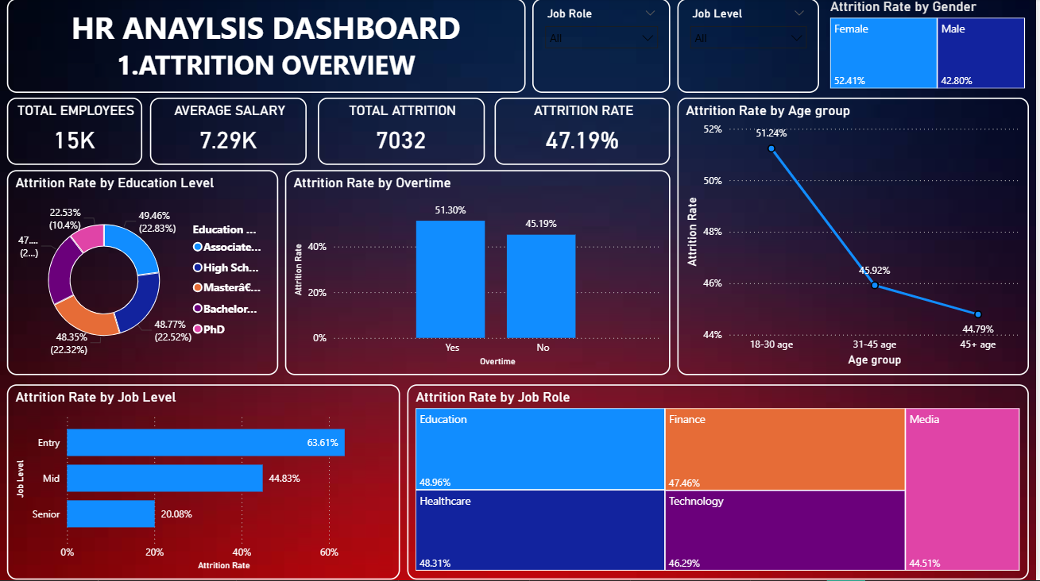
Power BI Dashboard-ATTRITION OVERVIEW
KEY FINDINGS:
1.WOMEN HAS A 52.41% OF ATTRITION RATE COMPARED TO MEN.
2.18 TO 30 AGE HAS 51.24% OF
ATTRITION RATE.
3.IN JOB ROLE-EDUCATION HAS 48.96% ATTRITION RATE BECAUSE OF LOW
SALARY
4.EMPLOYEES WHO WORK IN
OVERTIME BASIS HAS 51% OF
ATTRITION RATE.
5.EMPLOYEES WHO ARE IN ENTRY LEVEL HAS 63% OF ATTRITION
RATE

Slide 8
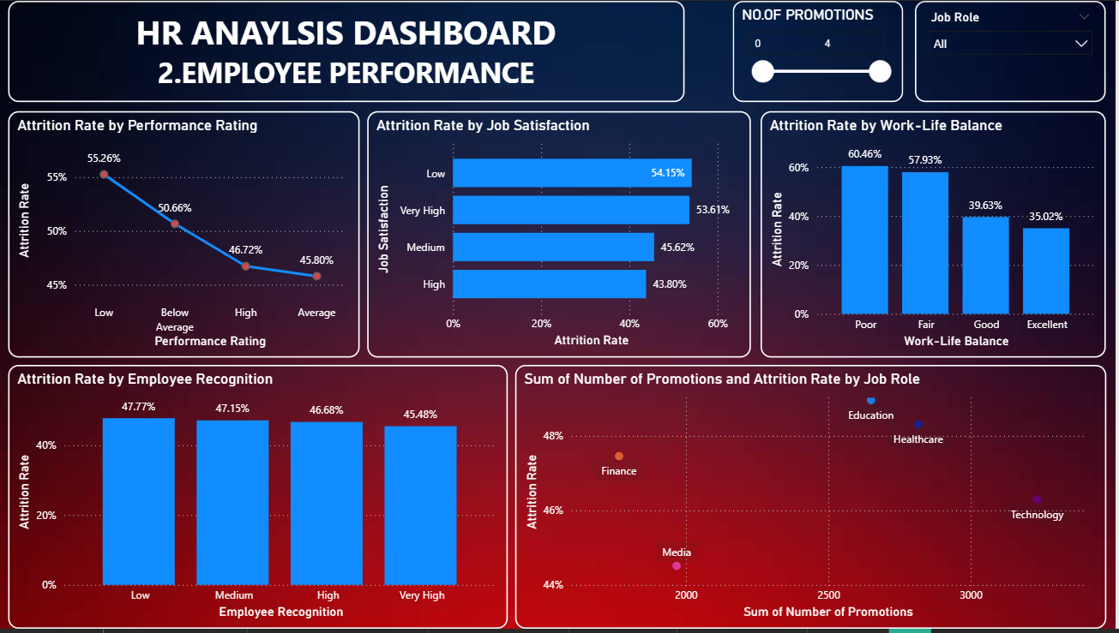
Power BI Dashboard-EMPLOYEE PERFORMANCE
KEY FINDINGS:
1.EMPLOYEES WHO HAD LOW
PERFORMANCE RATING HAS
55.26% OF ATTRITION RATE
2.EMPLOYEES WHO HAD LOW
SATISFACTION IN THIER JOB HAS
54.15% AND VERY HIGH
SATISFACTION IN THIER JOB HAS 53.61%
3.EMPLOYEES WHO HAVE POOR WORK LIFE BALANCE HAS 60.46% OF ATTRITION RATE.
4.FINANCE ROLE HAS LOW
PROMOTIONS AND ITS ATTRITION RATE IS 47.46%

Slide 9
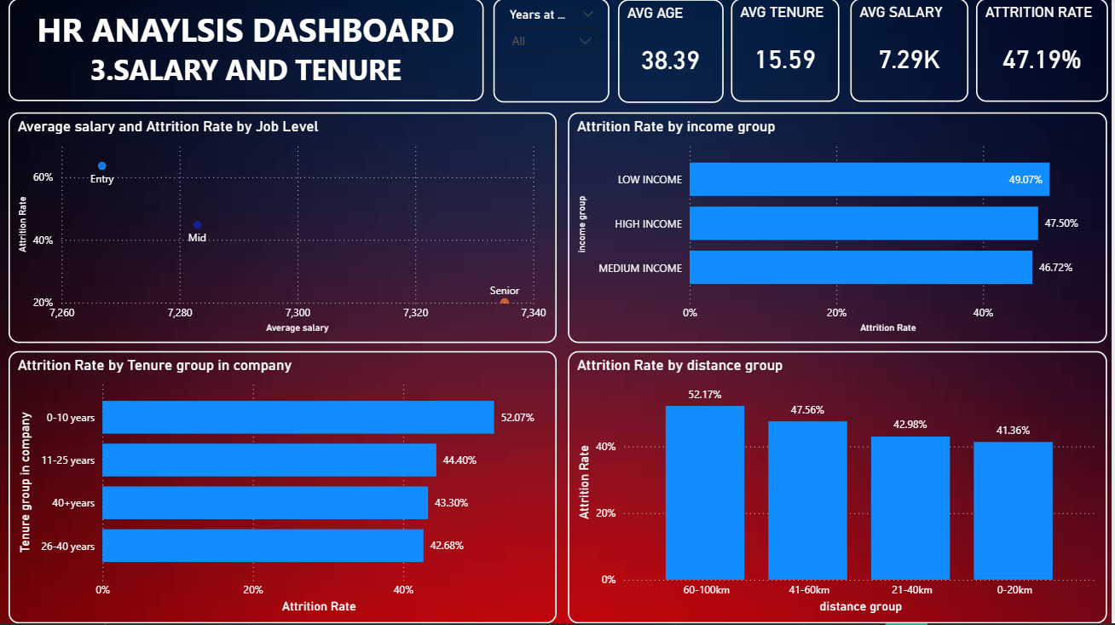
Power BI Dashboard-SALARY AND TENURE
KEY FINDINGS:
1.ENTRY LEVEL JOB WITH LOW SALARY HAS 63.61% OF
ATTRITION RATE.
2.LOW SALARY EMPLOYEES
HAS 49.07% OF ATTRITION
RATE.
3.EMPLOYEES WITH 0-10 YEARS OF TENURE HAS 52.07% OF ATTRITION RATE.
4.EMPLOYEES WHO HAS LONG DISTANCE OF COMPANY
FROM HOME(60-100 KM)HAS 52.17% OF
ATTRITION RATE

Slide 10
BUSINESS RECOMMENDATION
Employees aged 18–30 have a high attrition rate of 51%. Companies should provide proper training, mentorship, and structured team management for entry-level roles.
Education role employees leave due to low salary (49% attrition). Annual salary increments and performance-based promotions should be implemented across all job roles.
High performers should receive proper recognition and rewards. Low performers should be motivated and guided to bring out their best potential.
Employees struggling with work-life balance should be given flexibility so their job does not affect their personal life and well-being.
Employees with long commutes (60–100 km) should be offered weekly remote work or flexible timings to reduce personal impact.

